Slide 1
Section 1
The Hospitality Service Strategy
Notes:
Running a business without a plan is like going into the forest, shooting off your rifle and hoping that dinner runs into the bullet. –Herman Cain, Former Chairman and CEO, Godfather’s Pizza

Slide 2
Chapter 1
The Basics of Wow! The Guest Knows Best
The importance of Guest Experiences
Notes:
“Of course he is a crank, but we must please him. It is our business to please cranks. Anyone can please a gentleman.” –Fred Harvey

Slide 3
Objectives:
Gain an understanding of the differences between making products and creating experiences for guests.
Recognize the importance of guest experience and meeting guests’ expectations.
Identify the components of guest experiences.

Slide 4

Guestology: What Is It?
The study of guests—their wants, needs, expectations, and behaviors—with the aim of aligning the organization’s strategy, staff, and systems so as to provide outstanding service to guests
Notes:
1.1 Describe the key differences between making products and creating experiences for guests.

Slide 5
Meeting Customer Expectations
Understanding the guest
Treat customers like guests
Guests are studied
Demographics
Wants, needs, and expectations discovered
KSA
Notes:
1.1 Describe the key differences between making products and creating experiences for guests.

Slide 6
Guest Expectations
Meeting expectations
Reputation
Social media reviews
Anticipate expectations
Do not promise more than is possible to deliver
Serving internal customers
Internal customers v. external customers
Treat employees as well as guests
Notes:
1.4 State the importance of meeting the hospitality guest’s expectations

Slide 7
Components of the Guest Experience
The service product
The service setting
Service environment
Servicescape
The service delivery system
Human components
Physical production process
Notes:
1.2 State the importance of the guest experience.
1.3 Identify the components of the guest experience.

Slide 8
Service Encounters and Moments of Truth
Service encounter
The heart of service
Critical incident
Moment of truth
Notes:
1.2 State the importance of the guest experience.
1.3 Identify the components of the guest experience.

Slide 9
The Nature of Services
Intangibility
Services are partly or wholly intangible.
Cannot be grasped by one of the five senses.
Perishability
If not sold by a particular time, the opportunity to sell it again is gone forever.
Notes:
1.2 State the importance of the guest experience.
1.3 Identify the components of the guest experience.

Slide 10
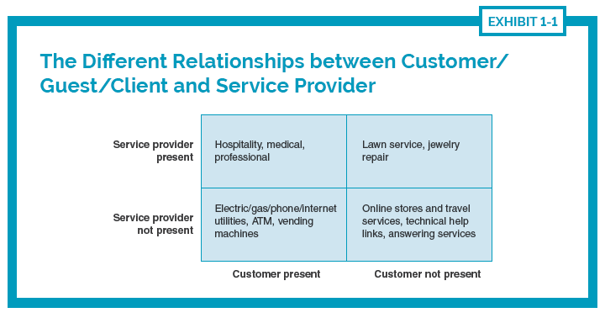
The Nature of Services
Inseparability
Services are consumed at the moment or during the period of production or delivery (Simultaneous production and consumption)
Services require interaction between the service provider and the customer, client, or guest
Notes:
1.2 State the importance of the guest experience.
1.3 Identify the components of the guest experience.

Slide 11
The Nature of Services
Heterogeneity
Delivery of services is inconsistent.
“Moment of truth” when the service product meets service delivery and consistency is key.
Customers are varied and have different wants and needs.

Slide 12
The Importance of Guestology
The traditional management model is insufficient
The hospitality industry needs guestology
All customers are guests
Employees are guests
Notes:
1.6 Explain the reasons why “it all starts with the guest.”

Slide 13
Service
Service industries
Goods to services to experiences
All industries involve service
Competitive advantage
Notes:
1.1 Describe the key differences between making products and creating experiences for guests.

Slide 14
Discussion
Reflect on a recent, enjoyable guest experience and on a disappointing guest experience.
What were the significant events, the moments of truth, during each experience? Summarize those key moments for one positive and one negative service encounters.
How did they contribute to your enjoyment or disappointment?
How do they relate to managing the guest experience in hospitality organizations? Are those key moments related to service product, service setting , or service delivery system?

